Slide 1


BE PROJECT 2023-24
Group : 6
B190082025 | Dyanesh Dhawale
B190082088 | Nishant Nirmal
B190082095 | Anurag Patil
B1900820137 | Abhishek Sontakke

Slide 2
AGENDA
Introduction
Problem Statement
Objectives
Literature Review
Proposed System
AI in Appraisal System
Conclusion

Slide 3
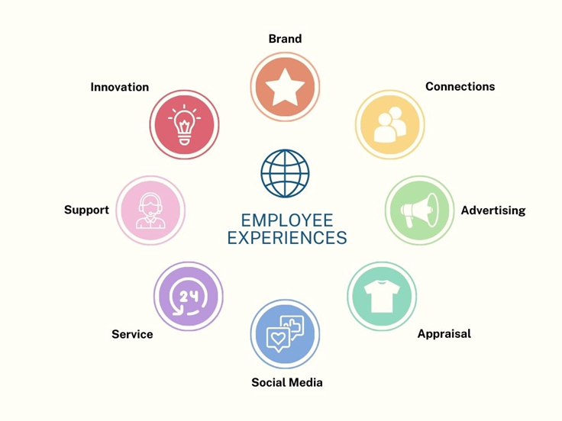
INTRODUCTION
We're living in a time where the way educational institutions evaluate teachers is changing. Instead of just using pen and paper, we're using technology to make things better. Our project is about using this technology to help teachers and institutions work together better.

Slide 4

2. PROBLEM STATEMENT
“A social media platform for empowering educators through credential showcases and appraisal systems."
Educators play a pivotal role in shaping society, yet their recognition often falls short of their contributions.
There is a lack of transparent and standardized criteria for evaluating educator performance, leading to inconsistency and bias in the appraisal process.
Limited avenues exist for educators to showcase their credentials and receive timely, paperless appraisals for their work.

Slide 5

3. OBJECTIVES
Develop a user-friendly social media platform exclusively for educators, offering them a space to showcase their qualifications
Implementing a Paperless Appraisal System
Data Visualizations
Downloadable Analytic Reports
Smart Autonomous Scoring using ML Model
Interactive and Role Based Dashboards and Privileges

Slide 6
4. LITERATURE REVIEW
Sr. No | Website Name | Founder | Key Findings
1 | LinkedIn | Reid Hoffman | LinkedIn enables People to showcase their credentials and experience, empowering them to build a strong online professional profile.
2 | Zoho People | Sridhar Vembu | Zoho People's performance appraisal system includes setting up the appraisal cycle, enabling self-appraisal and multi-rater feedback, defining review periods, and selecting the modules for assessment.

Slide 7

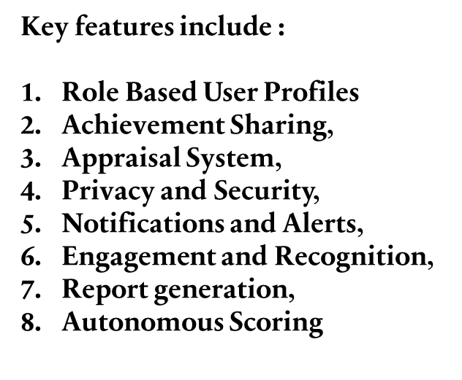
5. Proposed system
The proposed project is a web application designed to serve as a social media platform specifically tailored for educational organizations. Employees within the organization will have the ability to share their achievements and milestones on this platform. Additionally, the web app will be integrated with the organization's existing appraisal system, allowing higher authorities to provide performance appraisals to employees through the same platform.

Slide 8
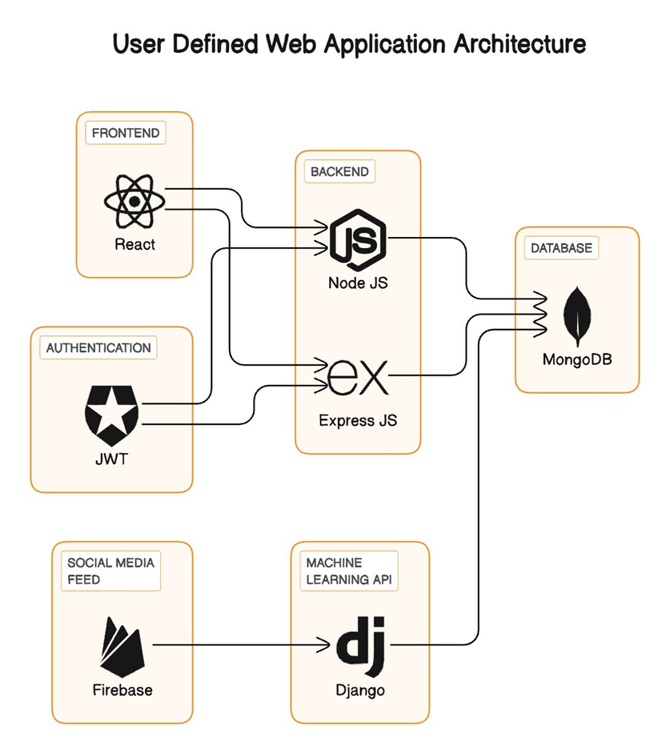
High level system

Slide 9
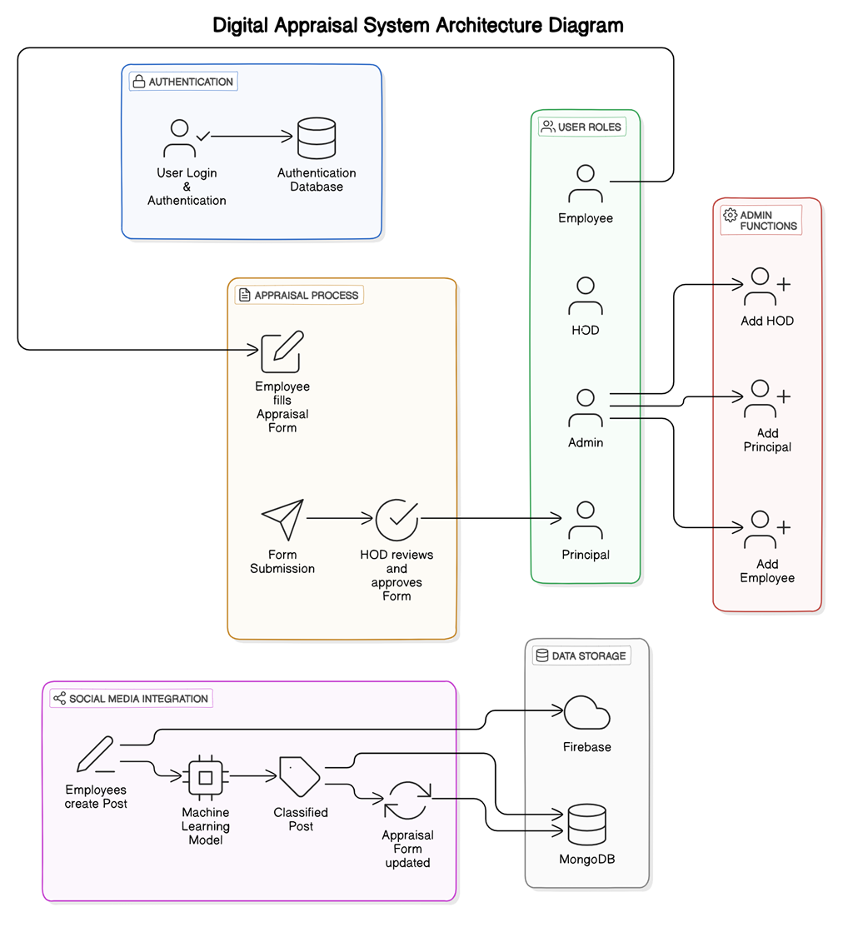

Slide 10

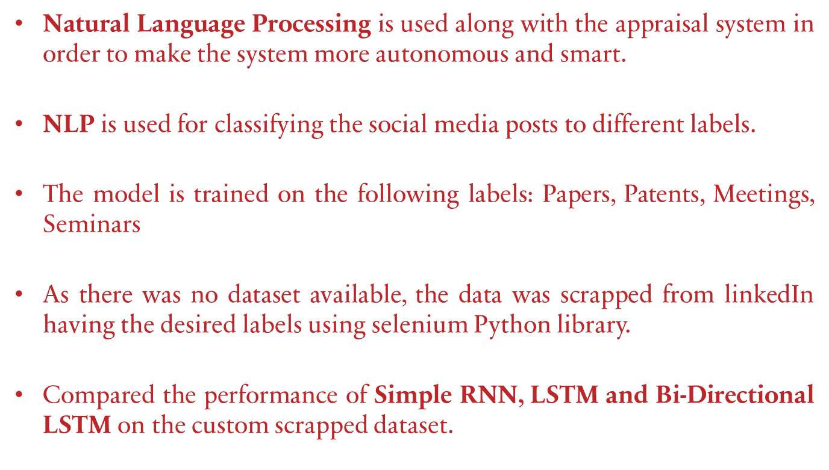
6. AI IN APPRAISAL SYSTEM

Slide 11
Model Development Life-Cycle
Data Gathering
Data Preprocessing
Model Selection and Training
Model Evaluation
Model Deployment

Slide 12
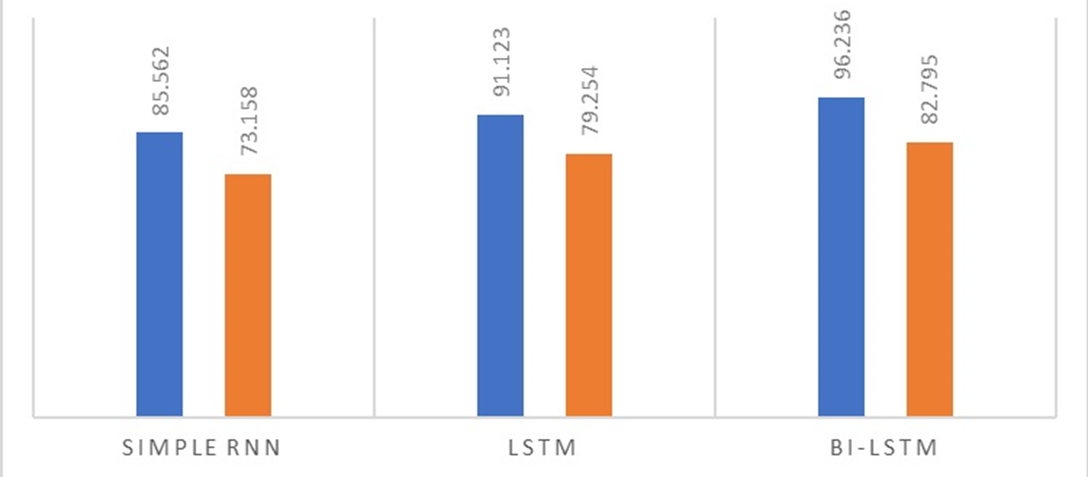
MODEL COMPARISON

Slide 13


Slide 14
7. CONCLUSION
Innovative college appraisal system with a unique blend of social media integration.
Seamless collaboration between efficient appraisal processes and a supportive community.
Cultural shift towards fostering appreciation and continuous improvement in education.
Holistic solution benefits administrators, educators, and heads of departments.
Catalyst for positive change, driving professional growth and celebrating achievements.
Stepping stone toward a future of collaborative, empowered, and connected education.

Slide 15
Thank You Group: 6

